Slide 1



Department of Information Technology
Final Year Project
Batch No: 4
First Review
Spatio-Temporal Attention Mechanism on MRI Slice Sequences for Multiple Sclerosis Diagnosis
TEAM MEMBERS :
Guide name:
Mrs. J MANJU, M.E
Assistant Professor
Abinash A
Monish V
Charukesh M
Mohammed Raashid S
- 113123UG07001
- 113123UG07072
- 113123UG07017
- 113123UG07069

Slide 2

INTRODUCTION
Multiple Sclerosis (MS) is an autoimmune disease that affects the central nervous system, specifically the brain and spinal cord.
In MS, the protective covering surrounding nerve fibres, known as myelin, becomes damaged.
This damage disrupts how nerve signals travel, which can lead to a wide range of neurological symptoms.
Doctors often use MRI scans to look for signs of MS, as these scans can show areas of damage (lesions or abnormalities) in the brain and spinal cord.

Slide 3
INTRODUCTION
Origin of the Proposal
While reviewing existing research on detecting multiple sclerosis from brain MRI scans, we found that most deep learning methods focus on individual MRI slices.
In real-world practice, radiologists examine how images change across slices, getting a fuller picture.
Inspired by this observation, we propose treating MRI data as a sequence of slices rather than isolated images.
We propose treating MRI data as a sequence of slices, rather than isolated images, to capture more context and potentially improve MS detection.

Slide 4
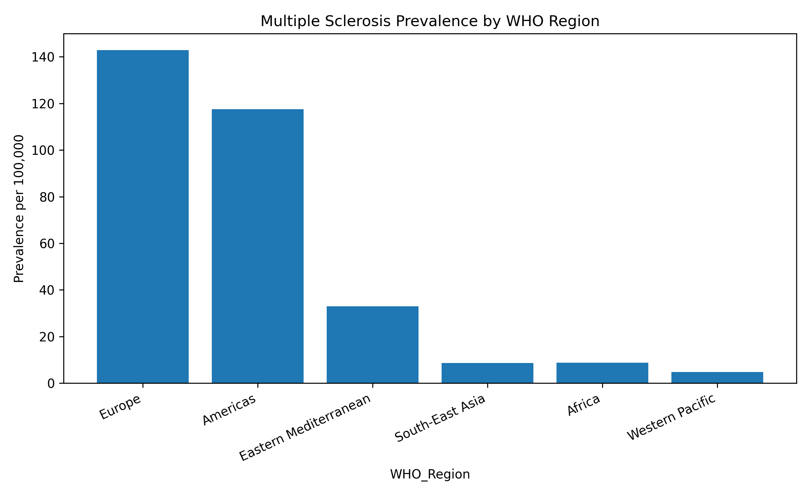
Review and Status of Research
International Status
MS is a chronic autoimmune disease that affects the central nervous system.
In 2023, 2.9 million people were living with MS worldwide.
The number rose from 2.3 million in 2013 to 2.9 million in 2023.
MS prevalence is higher in women than men, specifically in patients with relapsing forms of the disease.
Sources: Atlas of MS / MSIF.

Slide 5
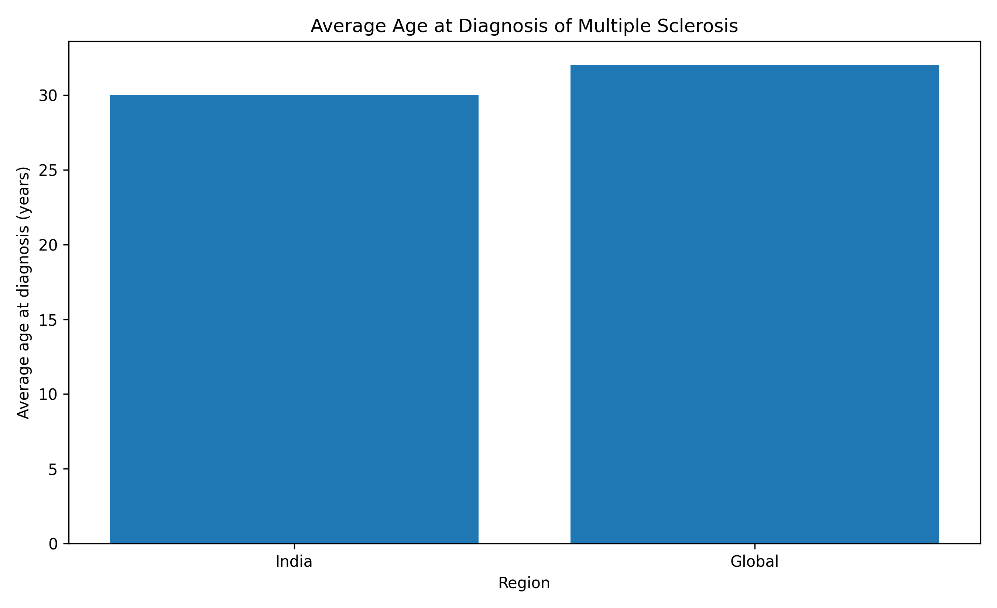
Review and Status of Research
National Status
MS is less common in India than in the West, but its prevalence is significant due to the country's massive population.
According to rough estimations, the number of people living with multiple sclerosis (MS) in India might be between 106,600 and 1,10,000.
That's roughly 7.8 cases per 100,000 people, with age-standardised prevalence rates.
Clinics report MS typically strikes young people and is slightly more common among women than men.
Sources: Indian MS studies.

Slide 6
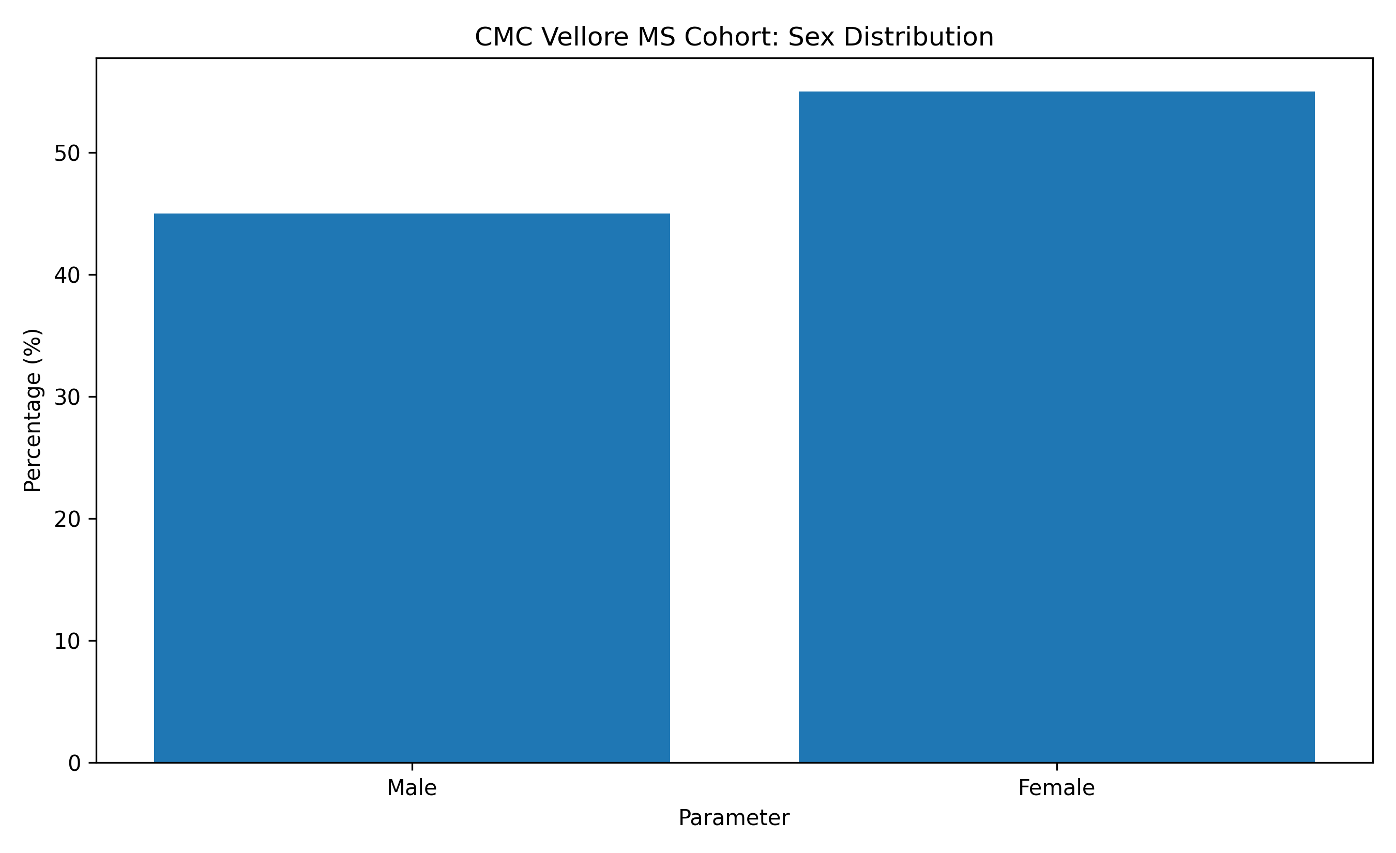
Review and Status of Research
Tamil Nadu Status
Regional data from Tamil Nadu and CMC Vellore show MS is slightly more common among females.
The relapsing-remitting form of MS is significantly more prevalent in South India.
Large publicly available databases are needed to validate these findings.
Extensive MRI studies of MS in India are required to produce high-quality data for further analysis.
Sources: Tamil Nadu clinical cohort literature.

Slide 7
SDG GOALS
Our project contributes to SDG 3: Good Health and Well-Being by demonstrating how artificial intelligence can be used to analyse Multiple Sclerosis, a neurological disease affecting the central nervous system.
Our project is dedicated to Multiple Sclerosis, a chronic disease affecting the brain and spinal cord, causing long-term demyelination and leading to neurological disability.
We aim to employ computer vision and deep learning methods to achieve computer-aided diagnosis of Multiple Sclerosis using brain MRI scans.
The proposed approach is expected to enable accurate identification of MS biomarkers.
Moreover, we have implemented the Grad-CAM explanation method, which allows us to visualize MRI regions contributing to the model’s decisions, thus making MS diagnosis more interpretable.
Hence, our project promotes health and well-being by facilitating the development of artificial intelligence-based medical image analysis for healthcare practitioners and helping to fight against Multiple Sclerosis specifically.

Slide 8
PROBLEM STATEMENT
Problem Identification
A patient's brain MRI scan consists of many sequential slices.
Many existing 2D CNN methods treat each slice as an independent image.
This can lead to loss of important information that exists between consecutive slices.
3D CNN methods capture the full volume, but at the cost of increased memory and computational demands.
Incorrectly splitting or shuffling slices during training can cause patient-level data leakage, rendering evaluation unreliable.

Slide 9
PROBLEM STATEMENT
Problem Statement
We aim to develop an efficient approach that can learn both:
The spatial details within individual MRI slices, and
The relationships between consecutive slices.
At the same time, the method should ensure a reliable, patient-level evaluation without data leakage.

Slide 10

EXISTING SYSTEM
1. 2D CNN-Based Methods
These methods take individual MRI slices as input, feeding them through a CNN for classification.
They excel in image-based analysis and are relatively lightweight.
However, they may overlook crucial information about feature changes across consecutive slices, since each slice is treated independently.
2. 3D CNN-Based Methods
These methods take the entire MRI volume (a stack of slices) as input and process it using a 3D CNN.
A 3D CNN processes the entire MRI volume, capturing spatial relationships in all three dimensions and providing a more complete view of the brain.
This approach requires significantly more memory and computational power, often becoming a bottleneck in resource-constrained settings.

Slide 11
LITERATURE SURVEY
S.No | Title | Author | Publisher | Vol/Pg No | Year | Algorithm | Merits | Demerits
1 | Multiple sclerosis classification and segmentation in neuroimaging MRI using different machine and deep learning techniques | R. M. Thabet et al. | Springer Nature – Artificial Intelligence Review | Vol. 58, Art. 255 | 2025 | CNN, U-Net, ConvLSTM, Attention, Transformers | •Comprehensive MS MRI review • Covers major DL methods | • No new model • Generalisation and XAI remain challenges
2 | MS-Trust: A Transformer Model with Causal-Global Dual Attention for Enhanced MRI-Based Multiple Sclerosis and Myelitis Detection | Salha M. Alzahrani | Springer Nature – Complex & Intelligent Systems | Vol. 11, Art. 331 | 2025 | Causal-Global Dual Attention, Cross-Attention, SE | • Attention-based MS detection • Captures global context | • No BiLSTM slice-sequence modelling • Further XAI exploration possible

Slide 12
LITERATURE SURVEY
S.No | Title | Author | Publisher | Vol/Pg No | Year | Algorithm | Merits | Demerits
3 | MS-DASPNet: Multiple Sclerosis lesion segmentation from brain MRI using dual attention and spatial pyramid pooling with transfer learning | Shikha Jain et al. | Frontiers – Frontiers in Computational Neuroscience | Vol. 19, Art. 1713766 | 2026 | VGG-16, ASPP, Dual Attention | • Multi-scale lesion features • Uses attention | • Mainly segmentation • Limited consecutive-slice modelling
4 | A Multiple Sclerosis MRI Dataset with Tri-Mask Annotations for Lesion Segmentation | Mahdi Bashiri Bawil et al. | Springer Nature – Scientific Data | Vol. 13, Art. 867 | 2026 | T1, T2, FLAIR, Tri-Mask | • Multi-sequence MRI dataset • Detailed lesion annotations | • Mainly segmentation-oriented • No sequence-attention model

Slide 13
LITERATURE SURVEY
S.No | Title | Author | Publisher | Vol/Pg No | Year | Algorithm | Merits | Demerits
5 | Hybrid deep learning and feature optimization approach for early detection of multiple sclerosis | Nandini Anam et al. | Frontiers – Frontiers in Human Neuroscience | Vol. 19, Art. 1685580 | 2026 | VGG-16, GLCM, CLAHE, WOA, ANN | • Combines deep + handcrafted features • Feature optimisation | • No sequential slice modelling • Limited slice-level XAI
6 | Multiple Sclerosis Lesion Analysis in Brain Magnetic Resonance Images: Techniques and Clinical Applications | Yang Ma et al. | IEEE – Journal of Biomedical and Health Informatics | Vol. 26, No. 6, pp. 2680–2692 | 2022 | Statistical methods, CNNs, Deep Learning, Domain Adaptation | • Comprehensive MS MRI review. • Covers traditional and deep-learning methods. | • No new model proposed. • Mainly focuses on lesion analysis. • MRI variability remains a challenge.

Slide 14
BASE PAPER
Selected Base Paper
Title: MS-Trust: A Transformer Model with Causal-Global Dual Attention for Enhanced MRI-Based Multiple Sclerosis and Myelitis Detection
Author: Salha M. Alzahrani
Journal: Complex & Intelligent Systems
Publisher: Springer Nature
Year: 2025
Volume: 11, Article 331

Slide 15
BASE PAPER
Main Approach
The model employs a compact convolutional tokenizer to extract meaningful features from MRI images, then builds on a Transformer-based architecture for classification.
It builds on a Transformer-based architecture to perform classification.
Two types of attention are combined:
Causal attention to capture sequential or local dependencies.
Global attention to understand broader, long-range relationships in the image.
The paper leverages attention mechanisms to automatically identify the most informative regions in MRI scans.
Cross-attention is employed to fuse different attention representations effectively.
Regularisation techniques like MixUp and CutMix improve generalisation and reduce overfitting.

Slide 16
BASE PAPER
Why We Selected This Paper
It focuses directly on MRI-based analysis for Multiple Sclerosis, aligning closely with our problem domain.
The paper leverages attention mechanisms to automatically identify the most informative regions in MRI scans.
Its causal attention component already considers sequential information, relevant to our slice-sequence idea.
The architecture provides a strong foundation for exploring attention-based models in MRI analysis.
The authors note that further evaluation and validation on different datasets are needed, giving us a clear direction to build upon.

Slide 17
RESEARCH GAP
Observations from Existing Research
Many methods analyse individual MRI slices without fully taking their sequence into account.
3D models capture volumetric information but come with higher computational costs.
MRI sequences such as T1, T2, and FLAIR carry complementary information that improves diagnosis.
Not all slices are created equal; some contain more relevant lesions or patterns.
Patient-level data splitting is necessary to prevent data leakage.
Medical imaging models should offer visual explanations to help clinicians understand predictions.

Slide 18
RESEARCH GAP
Identified Gap
There is a clear need for an approach that can:
  Extract strong spatial features from each slice,
  Learn the sequence relationships between consecutive slices,
  Identify and focus on the most important slices, and
  Ensure reliable, patient-level evaluation without leakage.
Our Proposed Direction
We propose a hybrid architecture that combines:
  EfficientNet-B0 for efficient spatial feature extraction from individual slices,
  BiLSTM to model the sequential dependencies across consecutive slices,
  Slice-Sequence Attention to weigh and highlight the most informative slices, and
  Grad-CAM to provide visual explanations of which regions in the MRI influenced the model’s decision.

Slide 19
OBJECTIVES
Main Objective
Design a deep learning framework to analyze Multiple Sclerosis from multi-sequence brain MRI scans (T1, T2, and FLAIR).
Specific Objectives
Review existing deep learning methods for MS detection and analysis from MRI data.
Prepare MRI inputs across three sequences: T1-weighted, T2-weighted, and FLAIR-weighted.
Apply preprocessing techniques to standardize and enhance MRI data.
Arrange consecutive MRI slices into a properly ordered sequence to preserve spatial continuity.
Use EfficientNet-B0 to extract spatial features from individual slices.

Slide 20
OBJECTIVES
Employ a Bidirectional Long Short-Term Memory (BiLSTM) layer to capture relationships between consecutive slices.
Integrate a slice-sequence attention mechanism to focus on the most informative slices.
Evaluate the model using subject-level 5-fold cross-validation for reliable patient-wise performance estimation.
Use Gradient-weighted Class Activation Mapping (Grad-CAM) to generate visual explanations highlighting brain regions influencing the model’s predictions.
Assess performance using standard classification metrics: accuracy, precision, recall, F1-score, and area under the receiver operating characteristic curve (AUC).

Slide 21
FEASIABILITY STUDY
Technical Feasibility
The project relies on established deep learning techniques.
EfficientNet-B0 is chosen as the backbone, offering strong feature extraction with minimal weight.
A BiLSTM layer processes an ordered sequence of slice-level features, capturing temporal dependencies.
An attention mechanism can be added to learn which slices are most important for the final prediction.
Grad-CAM provides interpretable visual explanations of the model’s decisions.

Slide 22
FEASIABILITY STUDY
Dataset Feasibility
The project can use publicly available brain MRI datasets with MS-related cases.
The final dataset selection will depend on several practical factors:
  The number of subjects available
  Which MRI modalities are provided (e.g., T1, T2, FLAIR)
  The availability and consistency of slice data
  The presence of clear class labels (e.g., MS vs. non-MS)
  Overall data quality and annotation reliability

Slide 23
FEASIABILITY STUDY
Computational Feasibility
Using EfficientNet-B0 keeps feature-extraction computationally efficient compared to heavier CNN architectures.
The proposed design avoids full 3D CNNs, reducing memory and GPU requirements.
This makes the approach feasible on standard research-grade hardware.
Project Feasibility
The work can be carried out in clear, manageable stages:
  Dataset selection and exploration
  Preprocessing and sequence preparation
  Model architecture development
  Training and hyperparameter tuning
  Evaluation using subject-level cross-validation
  Explainability analysis with Grad-CAM

Slide 24
METHODOLOGY
Steps | Methodology | Key Activities
1 | MRI Data Preparation | • T1, T2 and FLAIR MRI • Registration and preprocessing • Intensity normalization
2 | Slice Sequence Formation | • Ordered axial slices • Fixed-length sequence • Initially 24 consecutive slices
3 | Spatial–Sequential Feature Learning | • EfficientNet-B0 for spatial features • BiLSTM for slice-sequence learning
4 | Attention & MS Classification | • Slice-sequence attention • Important slice identification • MS prediction
5 | Explainability & Evaluation | • Grad-CAM visualization • Important region identification • Model performance evaluation

Slide 25
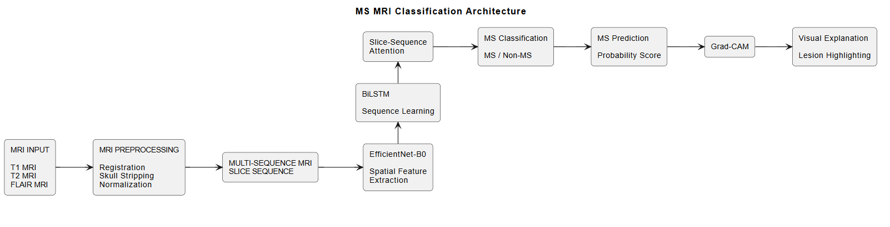
SYSTEM ARCHITECTURE

Slide 26
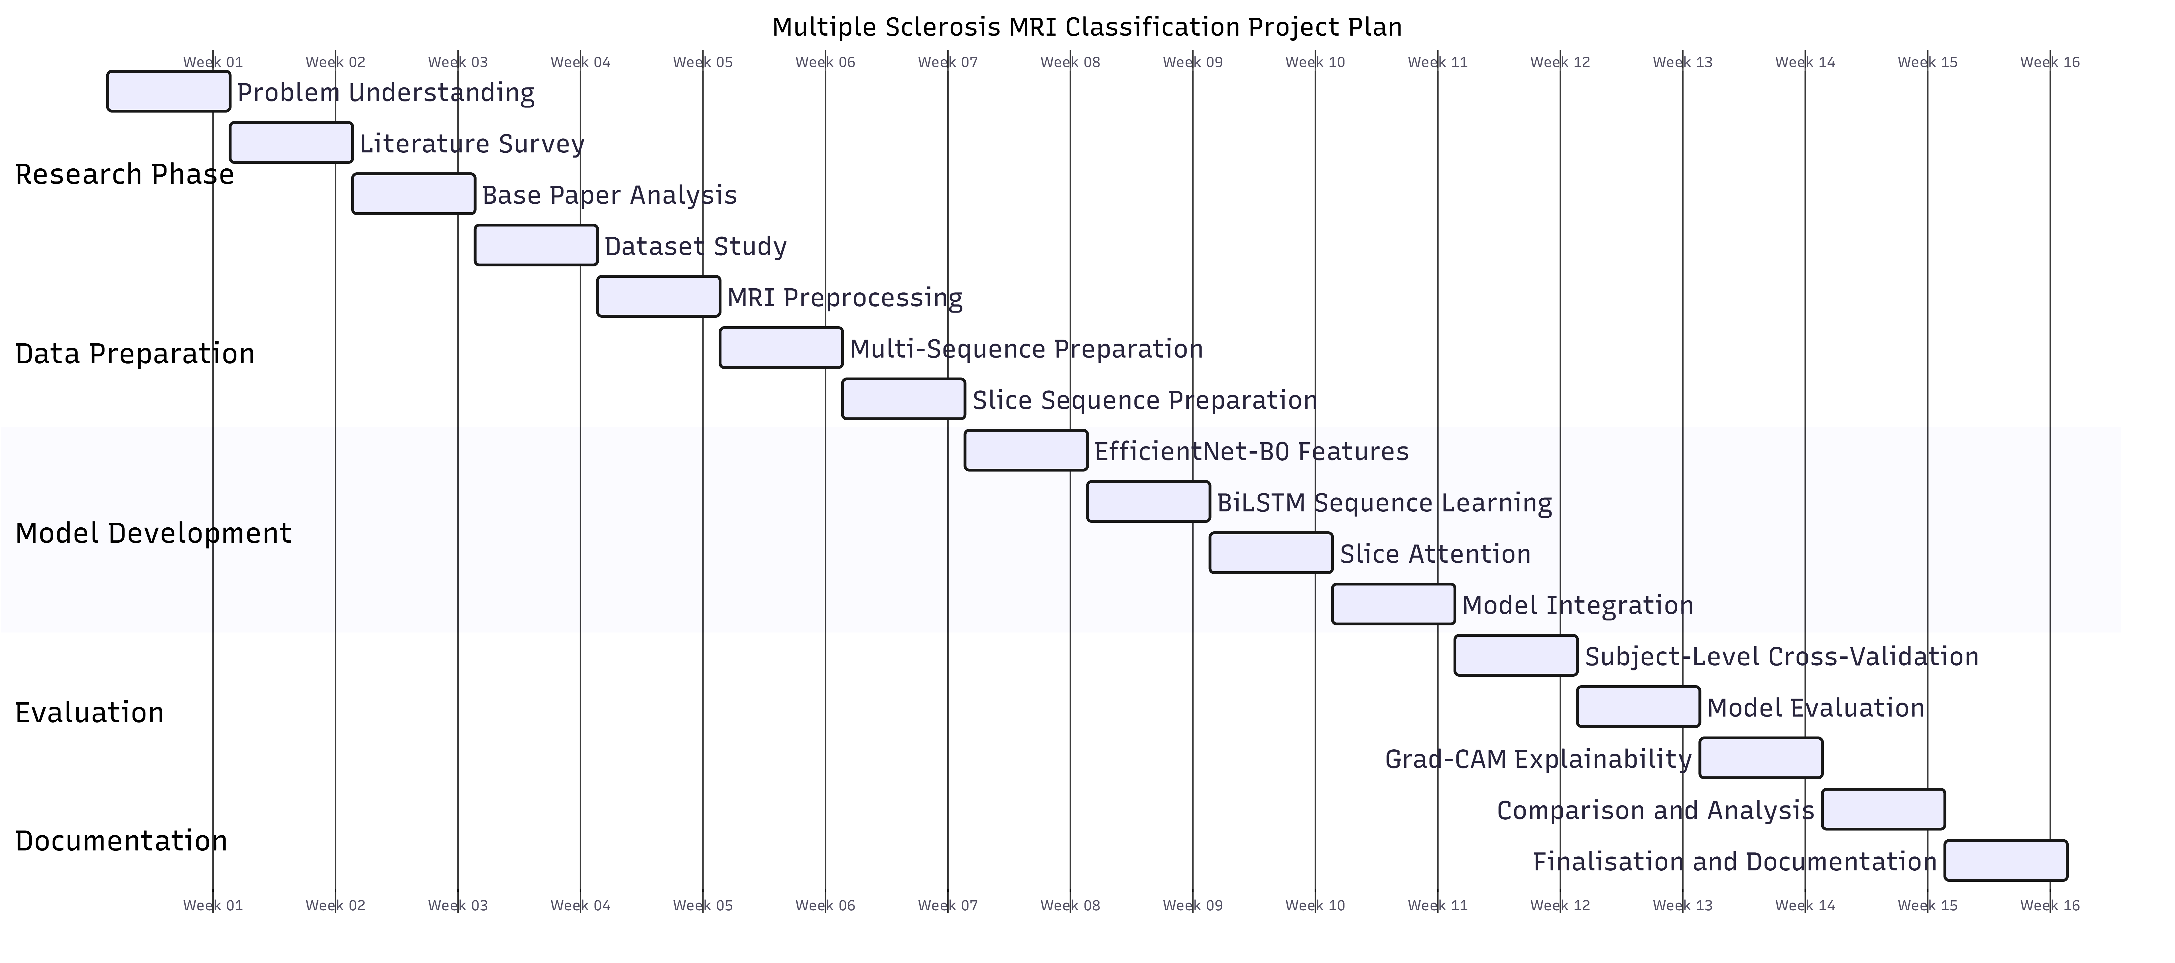
WORK PLAN

Slide 27
REFERENCE
[1] R. M. Thabet, H. A. Shedeed, M. Al-Berry, and D. Khattab, “Multiple sclerosis classification and segmentation in neuroimaging MRI using different machine and deep learning techniques: A review,” Artificial Intelligence Review, vol. 58, Art. 255, 2025.
[2] S. M. Alzahrani, “MS-Trust: A transformer model with causal-global dual attention for enhanced MRI-based multiple sclerosis and myelitis detection,” Complex & Intelligent Systems, vol. 11, Art. 331, 2025.
[3] S. Jain, N. Rajpal, and P. K. Soni, “MS-DASPNet: Multiple Sclerosis lesion segmentation from brain MRI using dual attention and spatial pyramid pooling with transfer learning,” Frontiers in Computational Neuroscience, 2026.
[4] M. B. Bawil, M. Shamsi, A. Ghalehasadi, et al., “A Multiple Sclerosis MRI Dataset with Tri-Mask Annotations for Lesion Segmentation,” Scientific Data, vol. 13, Art. 867, 2026.
[5] N. Anam, S. Basha, and C. L. Chowdhary, “Hybrid deep learning and feature optimization approach for early detection of multiple sclerosis,” Frontiers in Human Neuroscience, vol. 19, Art. 1685580, 2026.
[6] Y. Ma, C. Zhang, M. Cabezas, Y. Song, Z. Tang, D. Liu, W. Cai, M. Barnett, and C. Wang, “Multiple Sclerosis Lesion Analysis in Brain Magnetic Resonance Images: Techniques and Clinical Applications,” IEEE Journal of Biomedical and Health Informatics, vol. 26, no. 6, pp. 2680–2692, 2022.
[7] N. Gessert, J. Krüger, R. Opfer, A.-C. Ostwaldt, P. Manogaran, H. H. Kitzler, S. Schippling, and A. Schlaefer, “Multiple sclerosis lesion activity segmentation with attention-guided two-path CNNs,” Computerized Medical Imaging and Graphics, vol. 84, Art. 101772, 2020.

Slide 28
THANK YOU

